Slide 1

AGILE DEVELOPMENT
By: Chris Williford
Date: June 17, 2025
Notes:
Beginning of Agile Development presentation.

Slide 2

EXPLAINING AGILE ROLES
Notes:
Introduction to explaining Agile roles.
Image resource:
https://selfteam.org/wp-content/uploads/guest-interview-1-320x240.jpg

Slide 3
EXPLAINING AGILE ROLES
Product Owner
Represents stakeholders and customers
Responsible for defining the product backlog and prioritizing features
Scrum Master
Facilitates the Scrum process
Removes impediments
Ensures the team follows Agile principles
Development Team
Cross-functional group that works collaboratively to deliver increments of the product.
Notes:
Introducing Product Owner, Scrum Master, and Development Team roles.
Image resource:
https://selfteam.org/wp-content/uploads/guest-interview-1-320x240.jpg

Slide 4

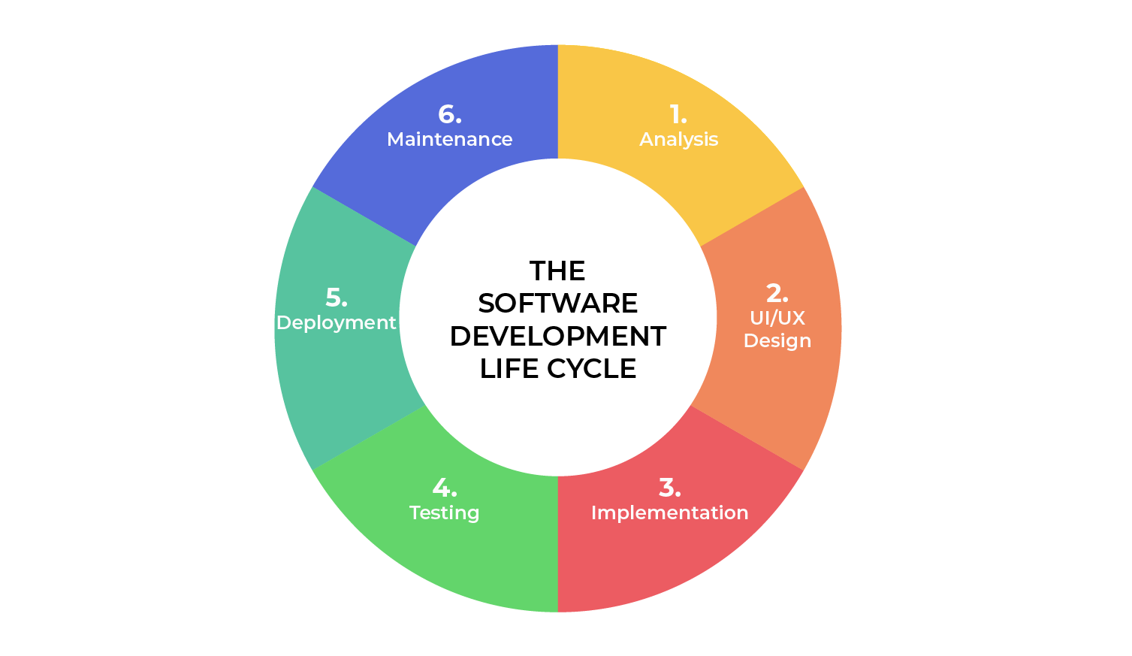
SOFTWARE DEVELOPMENT LIFECYCLE
Notes:
Introduction to software development lifecycle.
Image resource:
https://images.ctfassets.net/vp0agmmd9xgu/2n8RiT7Kql5oGJU5iDaBza/0aff682bfc2112e9b143fb15093caba3/My_project__1_.png?w=912&h=782&q=60&fm=webp

Slide 5
SOFTWARE DEVELOPMENT LIFECYCLE
Analysis
Collaborate with stakeholders
Gather requirements
2. Design
Define detailed process for functionality
Define wireframes, prototypes, and time frames
Implementation
Development begins
Functionality is broken up into smaller increments
Testing
Occurs in conjunction with Development
Process for identifying and mitigating reported defects and issue tracking
Deployment
Testing complete and deployed to production
Maintenance
Product is in production environment
Developers must be ready to implement NEW features and bug fixes as they come up
Notes:
Analysis – In this phase, the project team collaborates with stakeholders to define the project vision, goals, and high-level requirements. User stories are created to capture functional requirements.
Design – The team designs the architecture and user interface of the software. This phase may involve creating wireframes and prototypes.
Development – The actual coding takes place in this phase. Developers work in short iterations (sprints) to build features based on the prioritized user stories.
Testing – Testing is integrated throughout the development process. Continuous testing is performed to identify and fix defects early.
Deployment – Once the software is tested and approved, it is deployed to production. This can be done incrementally or as a whole.
Maintenance – Post-deployment, the team addresses any issues that arise and implements enhancements based on user feedback.
Image resource:
https://images.ctfassets.net/vp0agmmd9xgu/2n8RiT7Kql5oGJU5iDaBza/0aff682bfc2112e9b143fb15093caba3/My_project__1_.png?w=912&h=782&q=60&fm=webp

Slide 6

No need to define all requirements
Major requirements can be defined but functionality can evolve over time
No time to market constraint
All requirements must be defined
Contract Negotiation
Best for simple, unchanging projects
Notes:
Waterfall emphasizes comprehensive documentation at each stage whereas Agile focuses on working software over extensive documentation, promoting direct communication. The choice between Waterfall and Agile should be based on the specific needs of the project, the environment in which the team operates, and the nature of the requirements. Each approach has its strengths and weaknesses, and understanding these factors can lead to a more successful project outcome.
Reference for image:
https://impalaintech.com/wp-content/uploads/2023/05/Agile-vs.-Waterfall-Methodology-The-Battle-For-Efficiency-1024x386.webp

Slide 7
References
Beck, K., & Andres, C. (2019). *Extreme Programming Explained: Embrace Change* (2nd ed.). Addison-Wesley.
Conforto, E., Amaral, D. C., da Silva, S. L., & de Almeida, L. M. (2016). Can Agile Project Management Be Adopted by Traditional Project Management? *International Journal of Project Management*, 34(4), 681-693. https://doi.org/10.1016/j.ijproman.2015.11.002
Highsmith, J. (2021). *Agile Project Management: Creating Innovative Products* (2nd ed.). Addison-Wesley.
Sutherland, J., & Schwaber, K. (2020). *The Scrum Guide: The Definitive Guide to Scrum: The Rules of the Game*. Scrum.org. Retrieved from https://www.scrumguides.org/scrum-guide.html
Notes:
Reference page

